Slide 1
Welcome to Introduction to Web Scraping!
Please log onto the Etherpad:
https://pad.carpentries.org/2026-03-10-bham-intro-web-scraping
Add your details in the ‘Sign in’ section
Check if you have completed the Software Setup’

Slide 2
“Web scraping (web harvesting or web data extraction) is a computer software technique of extracting information from websites.”
Wikipedia https://en.wikipedia.org/wiki/Web_scraping
Web scraping typically targets one web site at a time to extract unstructured information and put it in a structured form for reuse.

Slide 3
Requesting a Web Page
Domain Name Server (DNS)
www.dogs.com
IP address
Request page
Web server
Data
Computer with browser
Response
HTML file

Slide 4
Browser Renders HTML
Domain Name Server (DNS)
www.dogs.com
IP address
Request page
Web server
Data
Computer with browser
All About Dogs
Browser renders HTML file
Response
HTML file

Slide 5
Browser Renders Local HTML File
An HTML file is just a text file with a specific format
The browser can render a local file as well as fetching and rendering a remote one
Computer with browser
All About Dogs
Browser renders HTML file
Local file
HTML file

Slide 6
Web Scraping Process
Domain Name Server (DNS)
www.dogs.com
IP address
Request page
Web server
Data
Computer with browser
Response
Extract data from HTML
HTML file
.csv or .xlsx file (for example)

Slide 7
Web Scraper Tool
Domain Name Server (DNS)
www.dogs.com
IP address
Request page
Web server
Data
Response
Extract data from HTML
We will use the Chrome Web Scraper extension to automate this
Some knowledge of HTML is needed to understand and fine-tune the process
HTML file
.csv or .xlsx file (for example)

Slide 8
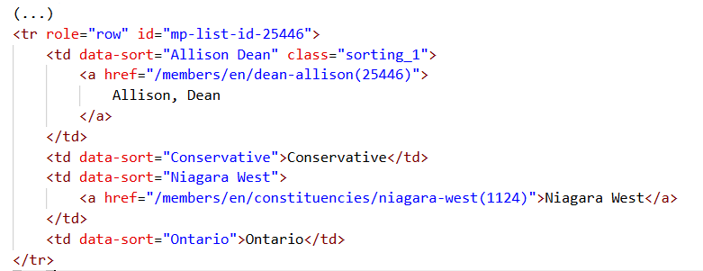
html code from Canadian MPs webpage

Slide 9
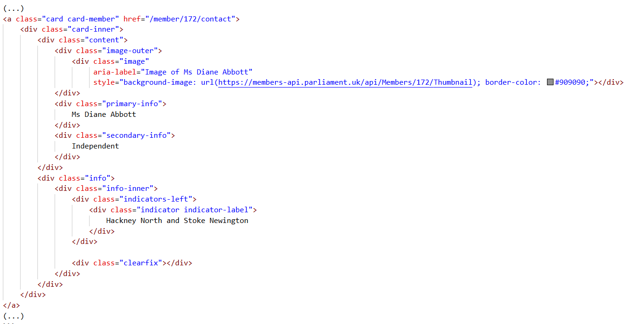
html code from UK MPs webpage

Slide 10
Web scraping might not be necessary
It might be possible (and quicker) to copy and paste data into a spreadsheet (probably only for small amounts of data)
Data may be available for download on a website
An API (application programming interface) may be provided for extraction of data
For much larger needs, Freedom of information Act (FOIA) requests can be useful. Be specific about the formats required for the data you want.

Slide 11
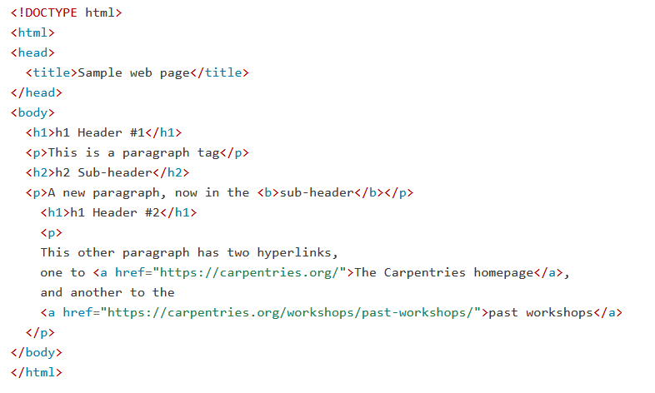
Hypertext Markup Language – HTML

Slide 12
Hypertext Markup Language – HTML
Elements marked by tags
All tags are in pairs with a start <x> and end </x> tag

Slide 13
Hypertext Markup Language – HTML
Text to be displayed by the element (between tags)

Slide 14
Hypertext Markup Language – HTML
Attributes give more information.
Located inside the start tag:
name = “value”
Here a link with name ‘href’
Text to be displayed on the hyperlink

Slide 15
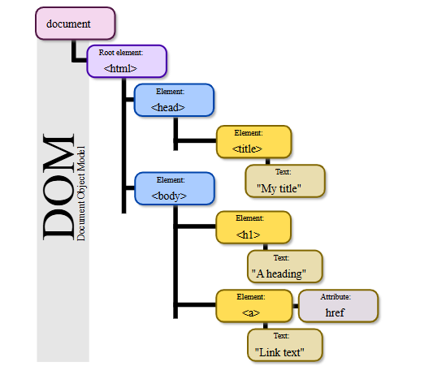
html Tree Format
Source: Wikipedia. Author: Birger Eriksson

Slide 16
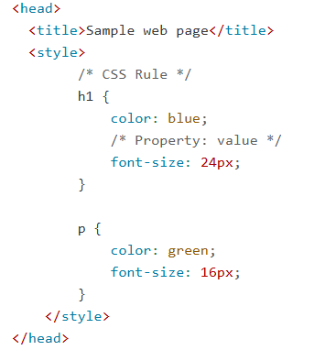
Cascading Style Sheet (CSS) Code

Slide 17
Overall Structure of the Lesson Webpage
<!doctype html>
<html lang="en" data-bs-theme="auto">
<head>
(...)
<title>Introduction to Web Scraping: Anatomy of a web page</title>
(...)
</head>
<body>
(...)
</body>
</html>

Slide 18
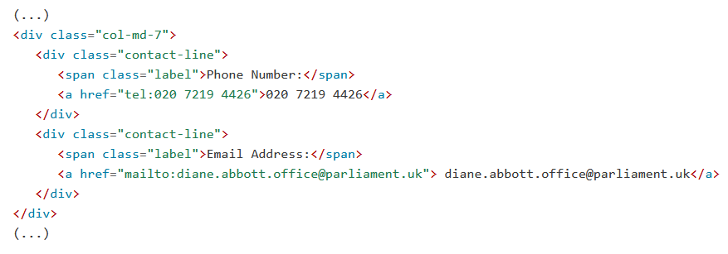
Email address
Selector: div.contact-line:nth-of-type(2) a

